Slide 1
Marketing campaign analytics

Slide 2
objective
Build a single, refreshable Power BI dashboard that lets marketing and stakeholders compare campaign performance between two beauty care products Tira and Purplle, to identify the best-performing campaign types, audiences, and channels, and track efficiency metrics— to guide budget reallocation across platforms and channels.

Slide 3
From Raw Data to Dashboard
Source File – 2
purplle_campaign_data-selected-columns13.csv
tira_campaign_data-selected-columns13.csv
Source Columns – 13 each
Total Rows – 55555 each (111110)
Calculated Columns - 2
DAX Measures – 19
Dashboard Pages - 5

Slide 4
Calculated Columns
Column | Formula
Total Cost | Acquisition_Cost * Conversions
Duration Bucket | SWITCH ( TRUE, [Duration] <= 10, "Short (≤10d)", [Duration] <= 20, "Medium (11–20d)", "Long (21–30d)" )
ROI Flag | IF ( Fact_Campaigns[ROI] < 0, "Loss-making", "Profitable"

Slide 5
DAX Measures
Measure | Formula
Total Revenue | SUM ( Fact_Campaigns[Revenue] )
Total Cost | SUM ( Fact_Campaigns[Total_Cost] )
Campaign Count | DISTINCTCOUNT ( Fact_Campaigns[Campaign_ID] )
CTR | DIVIDE ( [Total Clicks], [Total Impressions] )
Lead Rate | DIVIDE ( [Total Leads], [Total Clicks] )
Conversion Rate | DIVIDE ( [Total Conversions], [Total Leads] )
Funnel Rate | DIVIDE ( [Total Conversions], [Total Impressions] )

Slide 6
DAX Measures
Measure
Avg CPA | DIVIDE ( [Total Cost], [Total Conversions] )
ROAS | DIVIDE ( [Total Revenue], [Total Cost] )
ROI% | DIVIDE ( [Total Revenue] - [Total Cost], [Total Cost] )
Revenue per Conversion | DIVIDE ( [Total Revenue], [Total Conversions] )
Avg Campaign Duration | AVERAGE ( Fact_Campaigns[Duration] )
Negative-ROI Campaign Count | CALCULATE ( [Campaign Count], Fact_Campaigns[ROI] < 0 )
% Negative-ROI Campaigns | CALCULATE ( [Campaign Count], Fact_Campaigns[ROI] < 0 )
Platform Revenue Share % | DIVIDE ( [Total Revenue], CALCULATE ( [Total Revenue], ALL ( Dim_Platform ) ) )

Slide 7
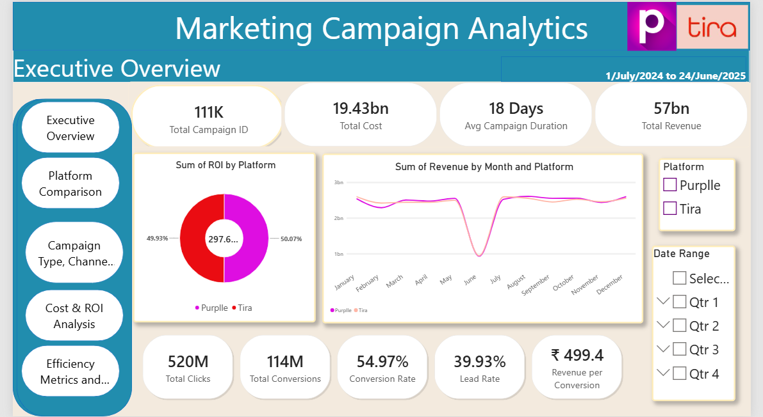

Slide 8
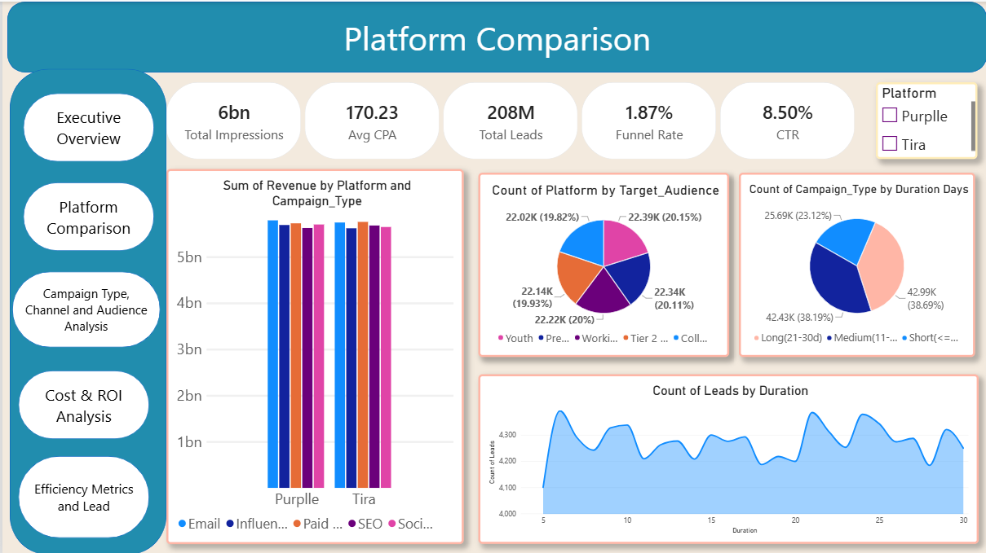

Slide 9
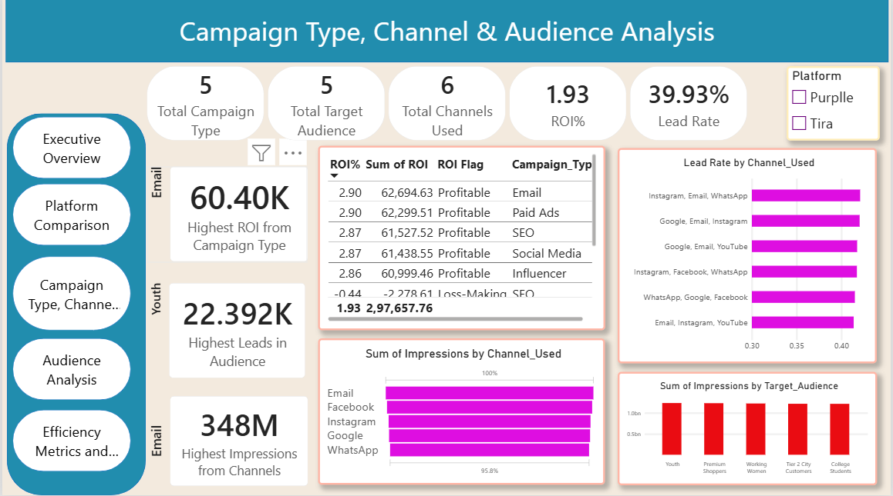

Slide 10
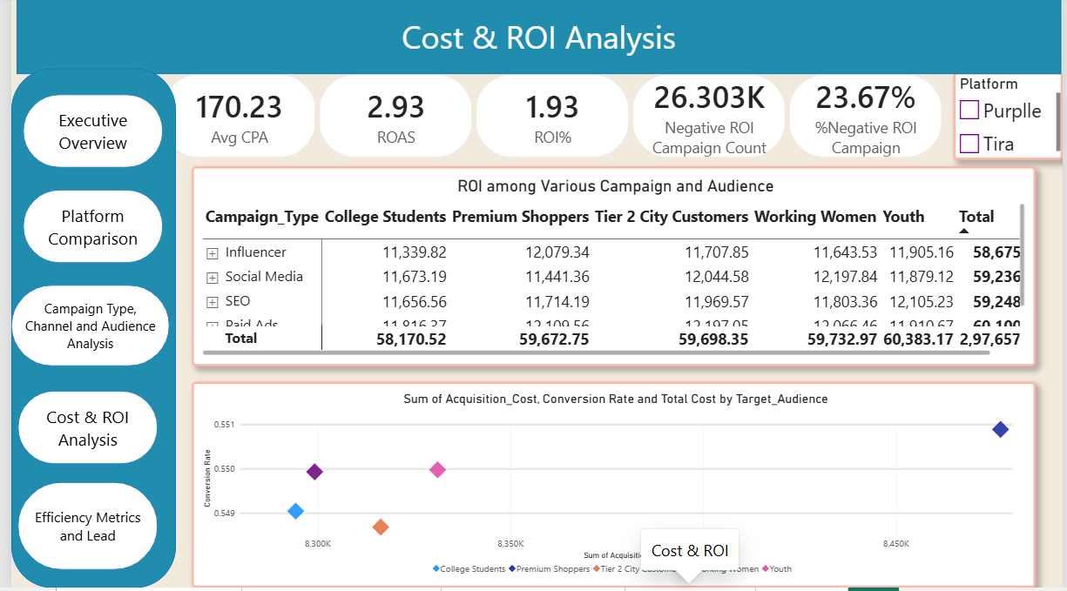

Slide 11
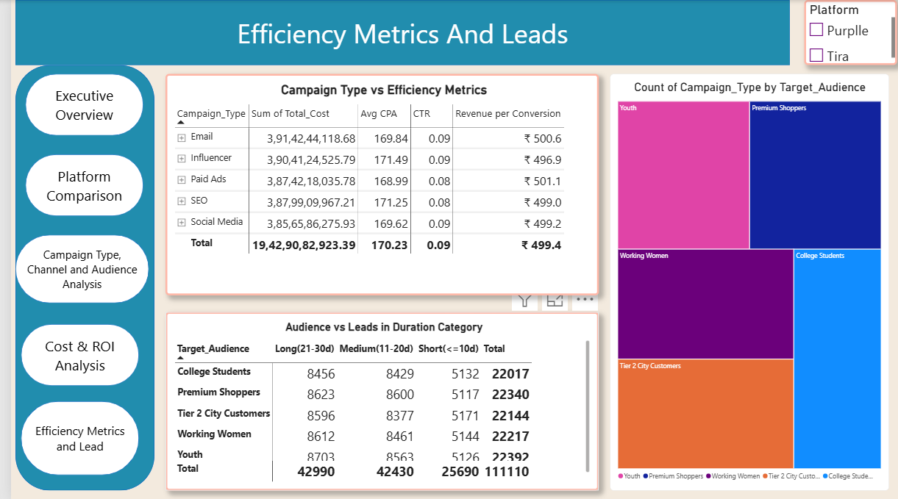

Slide 12
Summary
Generated 57 Billion in total revenue from 6 Billion impressions and 520M clicks
Achieved an average ROI of1.93% with a total spend of 19.43Bn
Average 8.5% CTR across active campaigns
Stood at 54.97% conversion rate from total leads to final sales
Email delivered highest ROI at 2.9%
Email campaign produced a strongest of 11.54Bn
Peak conversion periods occur for long duration campaigns
Youth were the highest spend audience in Purplle platform where as Premium Shoppers were more in Tira
Allocate more marketing fund towards Email workflow to maximise overall profitability
Refine targeting on higher cost channels like SEO to reduce acquisition cost

Slide 13
Thank you

